Slide 1

ECB1332- DESIGN PROJECT
SMART INVENTORY MONITORING SYSTEM
ELECTRONICS AND COMMUNICATION ENGINEERING
GUIDED BY
Dr.N.RADHA,Ph.D.,
ASSISTANT PROFESSOR,ECE
TEAM MEMBERS:
SHAHIN ASHIKA K (8115U23EC097)
SHRUTHI R (8115U23EC102)
SRI AMIRTHA VARSHINI S V (8115U23EC108)
SRI VIDHYA B (8115U23EC110)

Slide 2
CONTENTS
ABSTRACT
INTRODUCTION
LITERATURE SURVEY/RELATED WORK
EXISTING SYSTEM
CHALLENGES IN EXISTING SYSTEM
PROPOSED SYSTEM
BLOCK DIAGRAM
SOFTWARE/HARDWARE REQUIREMENTS
RESULTS AND DISCUSSION
ADVANTAGES
APPLICATIONS
CONCLUSION & FUTURE SCOPE

Slide 3
ABSTRACT
Manual inventory monitoring in shops, warehouses, hospitals, and industries is time-consuming, error-prone, and increases the risk of stock shortages, overstocking, and mismanagement.
The Smart Inventory Monitoring System automates stock measurement using a load cell–based weight sensing approach and identifies products using RFID technology to ensure accurate tracking. Abnormal conditions such as unauthorized removal or replacement are detected by identifying sudden unexplained changes in weight, without using any additional security sensors.
Low stock levels are monitored in real time, and alert notifications are generated to ensure timely restocking and efficient inventory control.

Slide 4
INTRODUCTION
Inventory management is an essential function in sectors such as shops, warehouses, hospitals, and industries, where accurate stock tracking is crucial for efficient operations.
Conventional inventory systems depend entirely on manual checking and barcode scanning, which are unreliable and time-consuming, especially in large-scale environments.
The Smart Inventory Monitoring System introduces an automated solution using load cell–based weight sensing to continuously track stock levels and detect abnormal conditions intelligently.
In addition, RFID-based identification provides accurate product tracking and enhances security, helping to prevent unauthorized removal and improve overall inventory management efficiency.

Slide 5
LITERATURE SURVEY
Title | Author(s) | Year | Key Insights | Drawback
IoT Impact on Inventory Management | Y. Mashayekhy et al. | 2022 | IoT improves real-time tracking, visibility, and supply chain efficiency | Requires cloud setup and high initial cost
IoT-Based Smart Inventory System using Weight Sensors | S. Rezwan et al. | 2018 | Uses weight sensors and NodeMCU to monitor stock and send alerts automatically | Limited to small-scale applications (ResearchGate)
RFID-Based Inventory Management System | S. Valli et al. | 2023 | RFID enables automatic identification and real-time inventory tracking | Needs proper RFID infrastructure and setup (IJRASET)
IoT Asset Management using RFID & ESP8266 | J. Ristono et al. | 2024 | Combines RFID and ESP8266 for accurate and low-cost asset tracking | Dependent on internet connectivity (Journal Center)

Slide 6
EXISTING SYSTEM
• Inventory levels are checked manually by staff. • Stock details are recorded in registers or basic systems. • Monitoring depends completely on human effort. • No real-time tracking or alert mechanism is available. • Stock shortages or overstocking are identified late. • System becomes inefficient and error-prone in large environments.

Slide 7
CHALLENGES IN EXISTING SYSTEM
• Time-consuming due to manual monitoring. • Prone to human errors in stock recording. • No real-time tracking of inventory levels. • Delay in identifying stock shortages or overstocking. • No security to detect unauthorized removal or replacement. • Increased labor effort and operational cost. • Inefficient for large-scale inventory management.

Slide 8
PROPOSED SYSTEM
The proposed system, Smart Inventory Monitoring System, provides an automated and efficient solution for inventory management using load cell sensors and RFID technology. The load cell continuously measures the weight of items to determine stock levels, while RFID ensures accurate product identification and enhances security. An ESP8266 microcontroller processes the data and transmits it to a cloud platform via Wi-Fi, enabling real-time monitoring through a mobile application. The system also detects abnormal conditions such as unauthorized removal or sudden stock changes and generates alert notifications when inventory levels fall below a predefined threshold. This approach reduces manual effort, improves accuracy, enhances security, and ensures efficient and reliable inventory management.

Slide 9
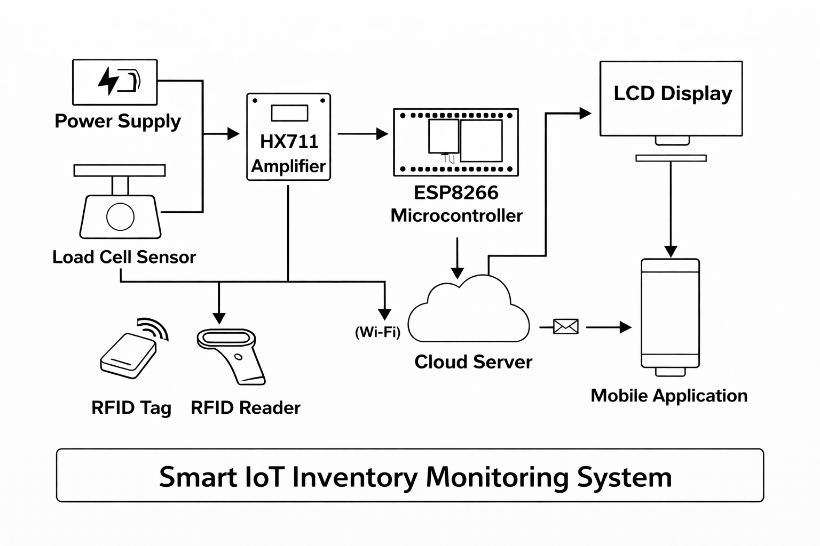
BLOCK DIAGRAM

Slide 10
EXPLANATION
Power Supply : The power supply provides the required power to the ESP32 microcontroller, load cell sensor, HX711 module, RFID reader, and LCD display. It ensures smooth and continuous operation of the entire system.
Load Cell Sensor : The load cell sensor measures the weight of the items placed on the shelf and converts the weight into an electrical signal.
HX711 Amplifier : The HX711 module receives the signal from the load cell sensor, amplifies it, and converts it into digital data, which is then sent to the ESP32 microcontroller.
RFID Reader : The RFID reader reads data from RFID tags attached to each product and sends the identification information to the ESP32.
RFID Tag : The RFID tag stores unique identification data for each product, enabling accurate tracking and security.

Slide 11
EXPLANATION
ESP32 Microcontroller : The ESP32 acts as the brain of the system. It processes weight and RFID data, calculates stock levels, and sends the information to the cloud server using Wi-Fi.
LCD Display : The LCD display shows real-time stock levels and system status for local monitoring.
Cloud Server : The cloud server stores and manages inventory data, allowing remote access and monitoring.
Mobile Application : The mobile application allows users to view inventory details in real time from anywhere.
Alert Notification : The system sends alerts when stock levels fall below a predefined threshold or when abnormal changes are detected.

Slide 12
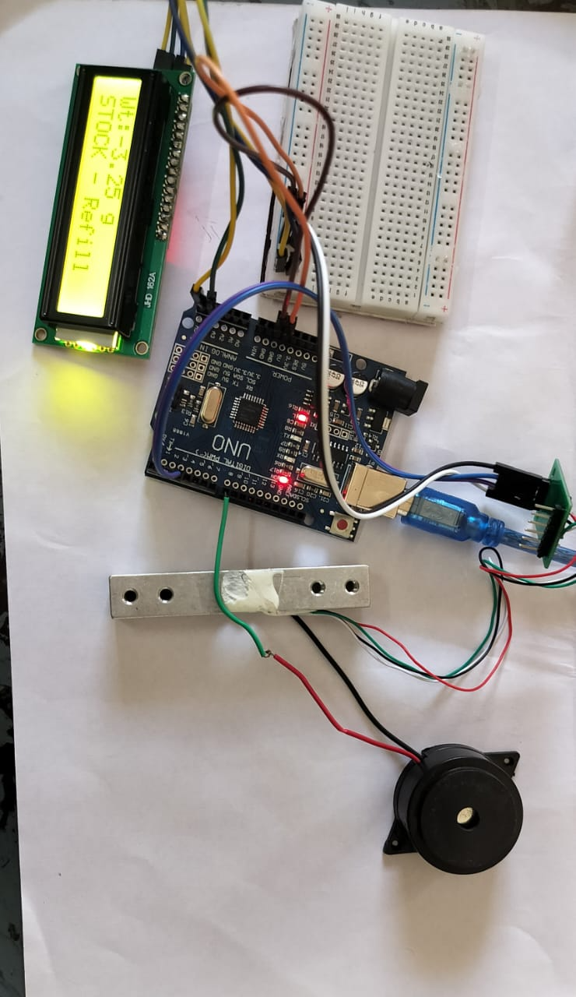
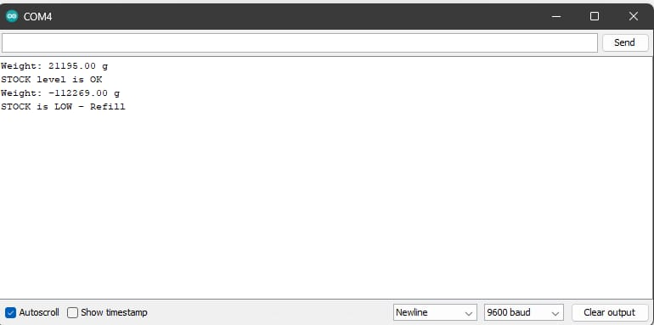
RESULTS AND DISCUSSION

Slide 13
ADVANTAGES
Reduces human effort (less manual work)
Saves time
Gives accurate stock details
Real-time monitoring (live updates)
Easy to access using mobile app
Reduces chances of errors
Improves security using RFID (prevents theft)
Automatic stock update

Slide 14
APPLICATIONS
Supermarkets and retail shops
Warehouses
Hospitals (medicine tracking)
Industries and factories
Libraries
Shopping malls
Storage and supply chain management

Slide 15
CONCLUSION & FUTURE SCOPE
Smart IoT system enables automatic inventory monitoring
Load cell ensure accurate tracking and identification
ESP8266 microcontroller provides real-time updates
Reduces manual effort and improves efficiency
FUTURE SCOPE
AI-based demand prediction
Automatic restocking system
Advanced mobile app features
Integration with supply chain systems

Slide 16
Thank you!

